Slide 1
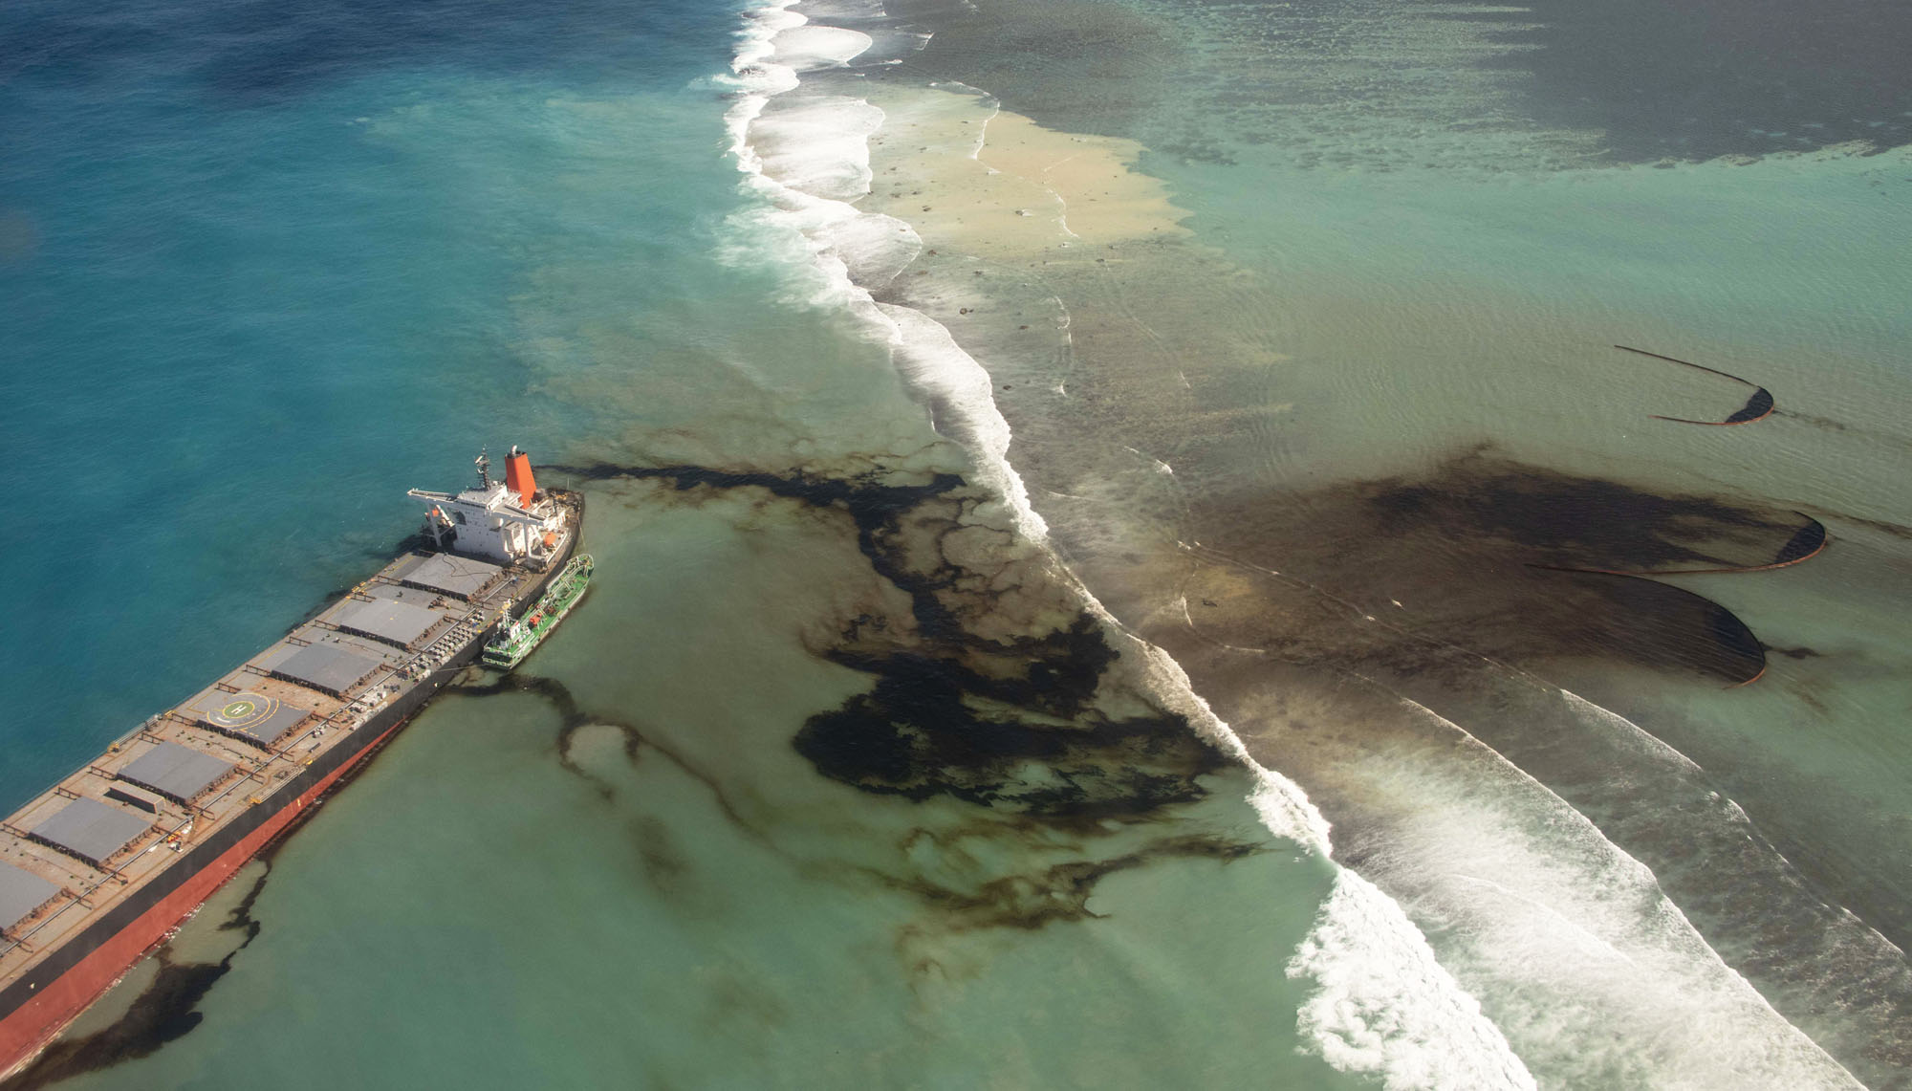
Mauritius Oil Spill Presented by Adalynn Mai

Slide 2
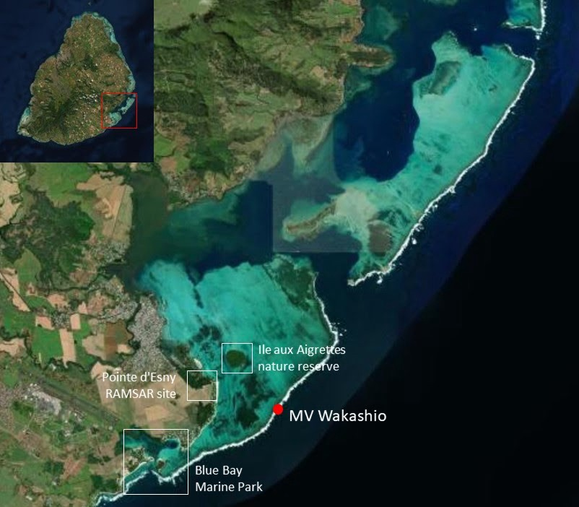
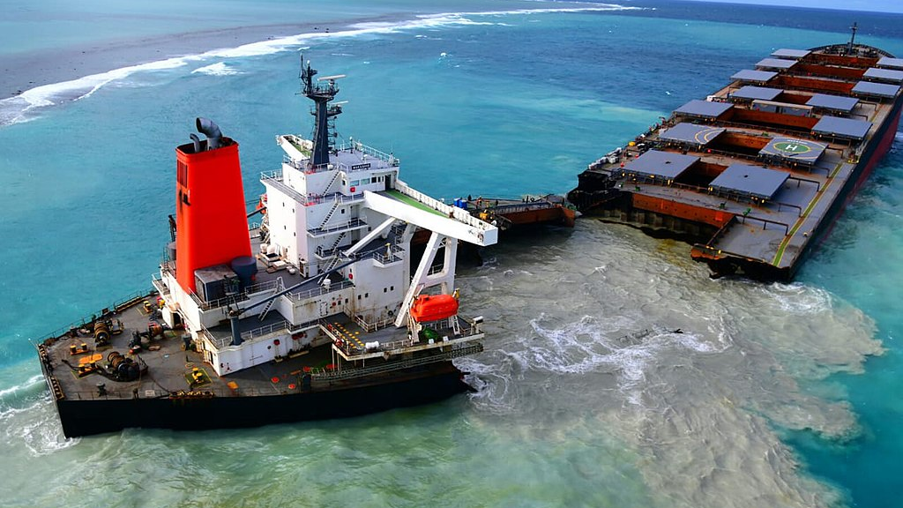
What happened?
July 25, 2020: Japanese bulk carrier Wakashio ran aground on a coral reef south of Mauritius
August 6, 2020: Fuel oil began to leak, and the ship broke in half in mid-August
Estimated 1,000 tonnes of oil were spilled into the ocean

Slide 3
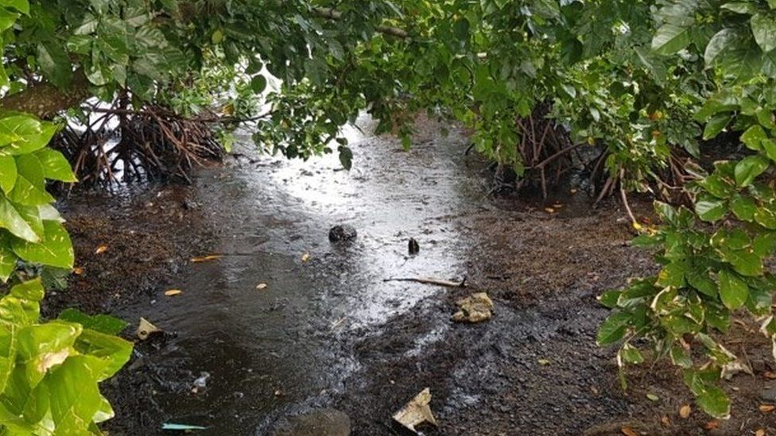
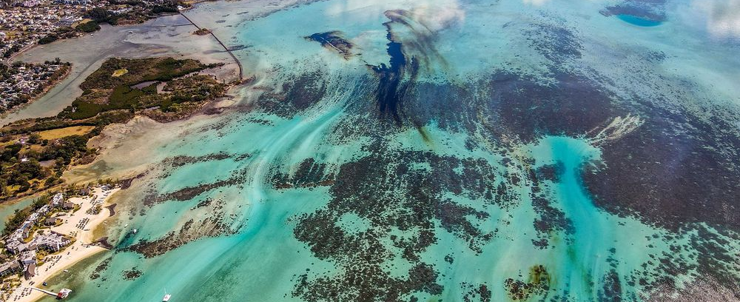
Environmental Impact
The amount of oil spilled in Mauritius is lower than others in history
Deepwater Horizon spill (2010): 492,000 tonnes
Disastrous for environment: a global biodiversity hotspot
Ramsar convention list on wetlands of international importance
Home to > 1,700 marine species
Strong wind and currents disperse the spill quickly
Impacted mangroves, seagrasses, coral reefs, and various marine mammals
Residues can remain in the sediments

Slide 4
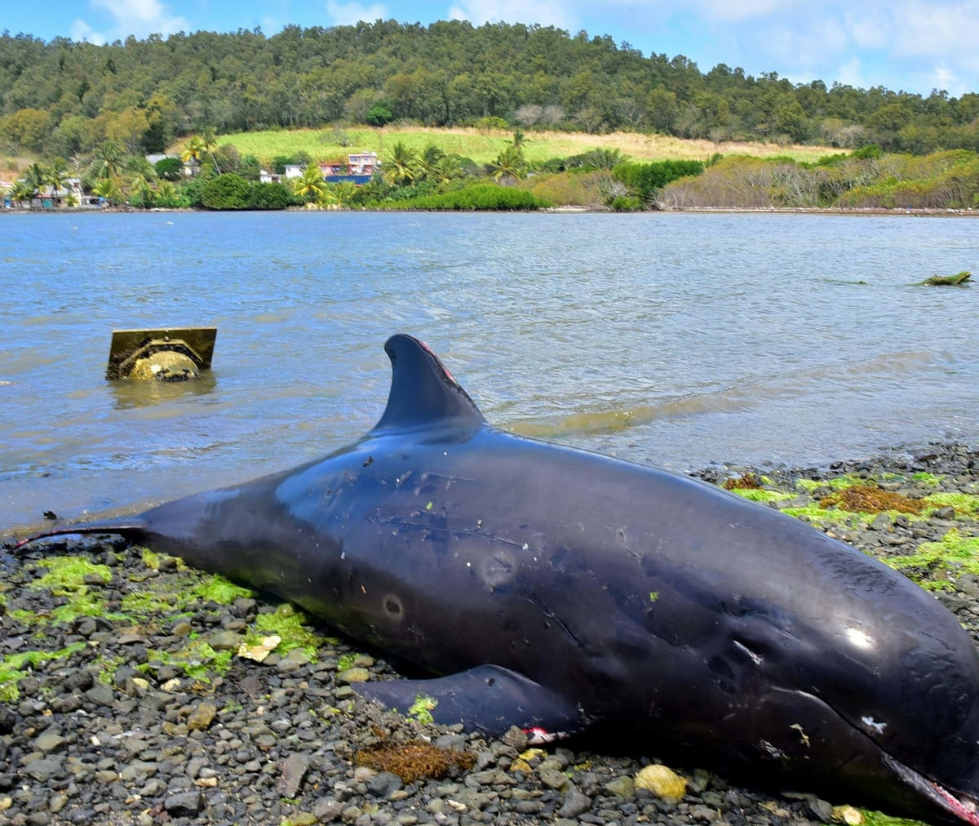
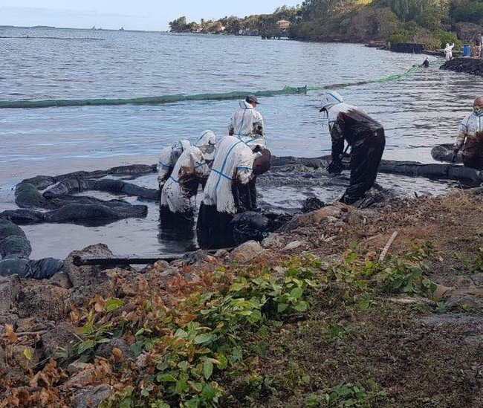
Cleanup and Aftermath

Slide 5
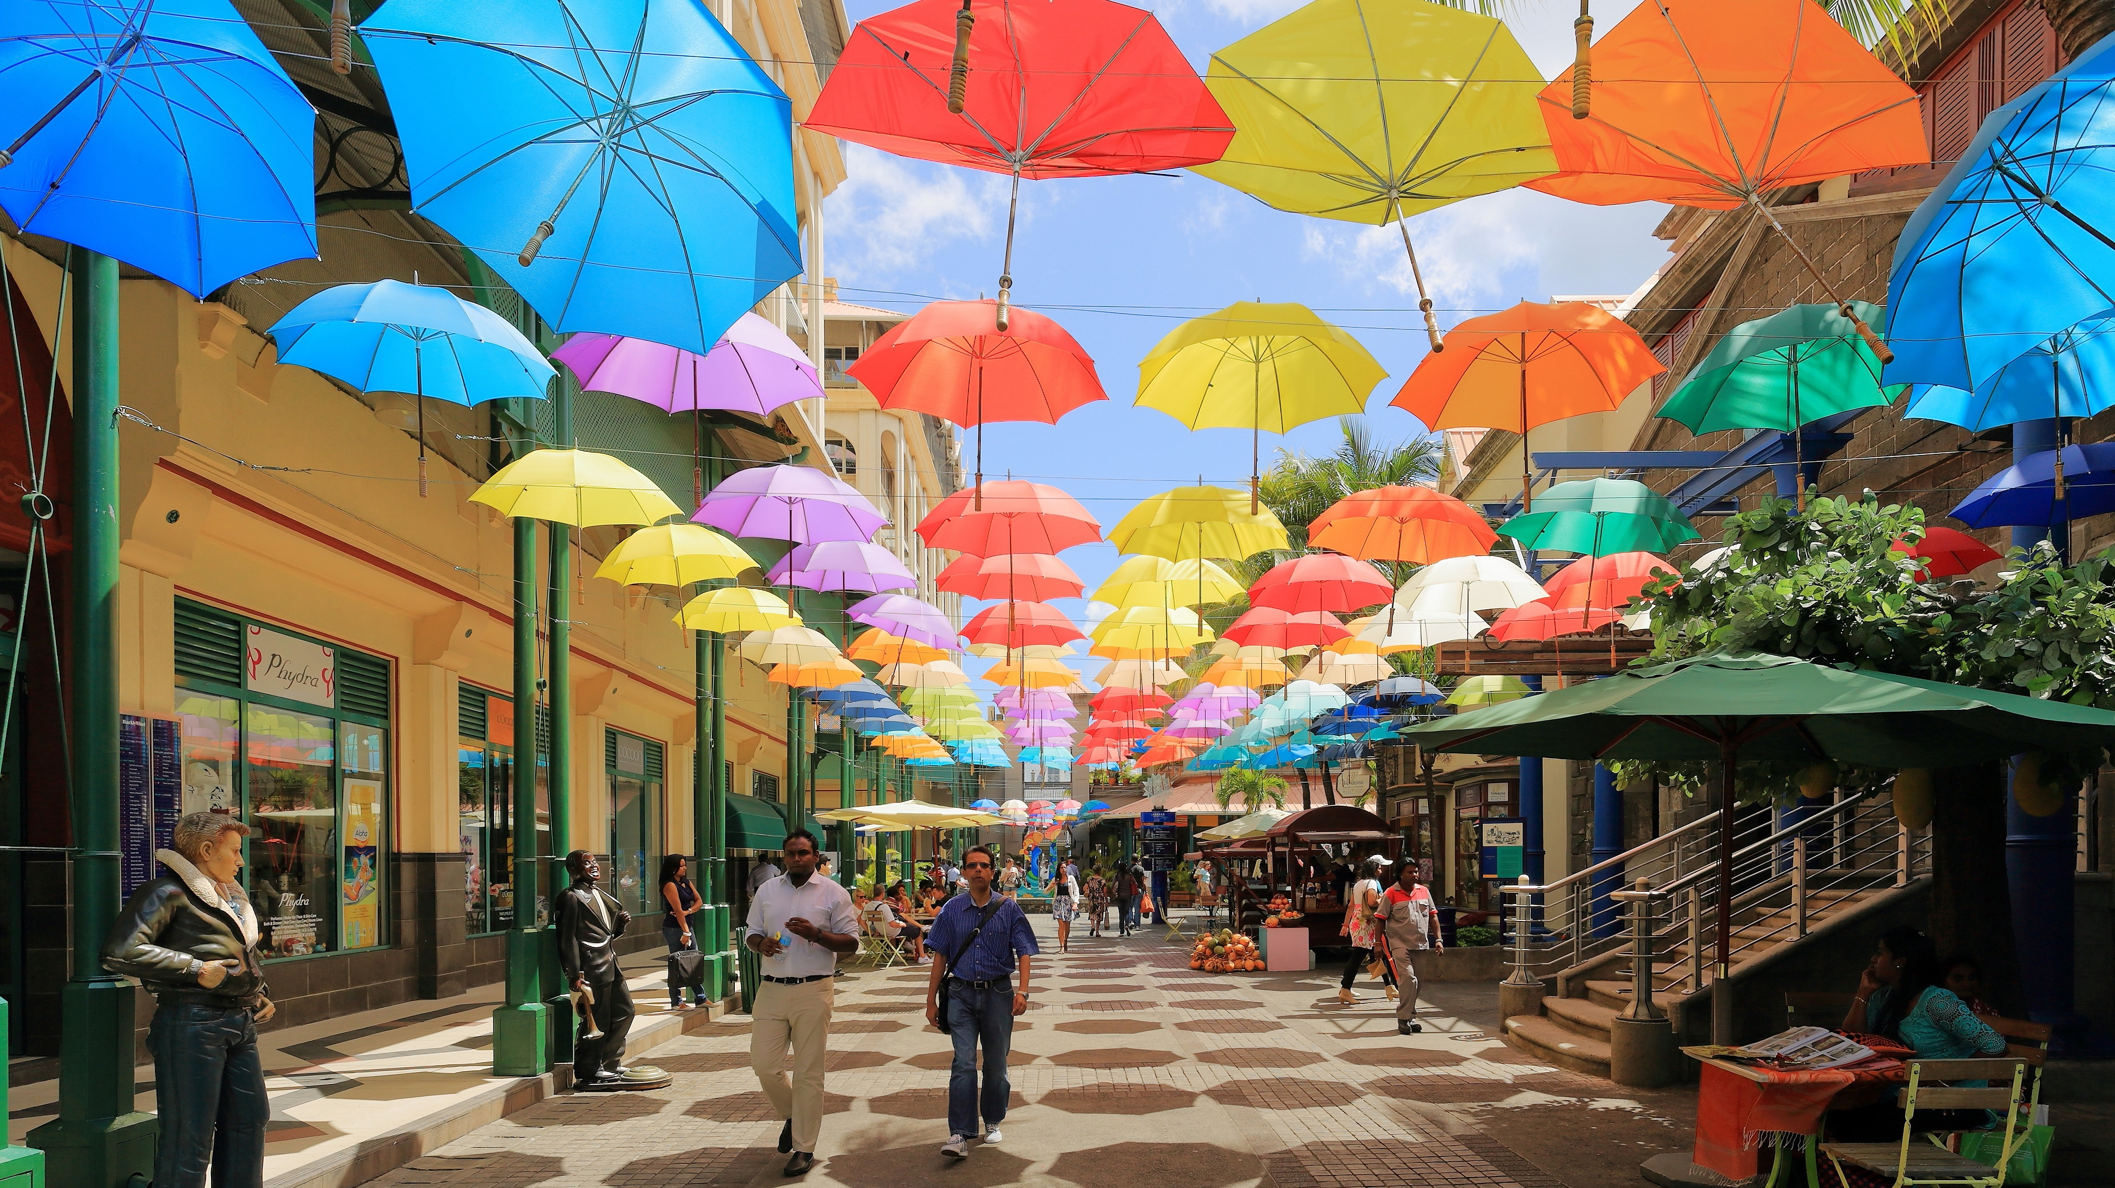
Economic Impact
Tourism
$1.6 billion in 2019
Employed 1/5 of the country’s workforce
Commercial fisheries
Seafood export

Slide 6
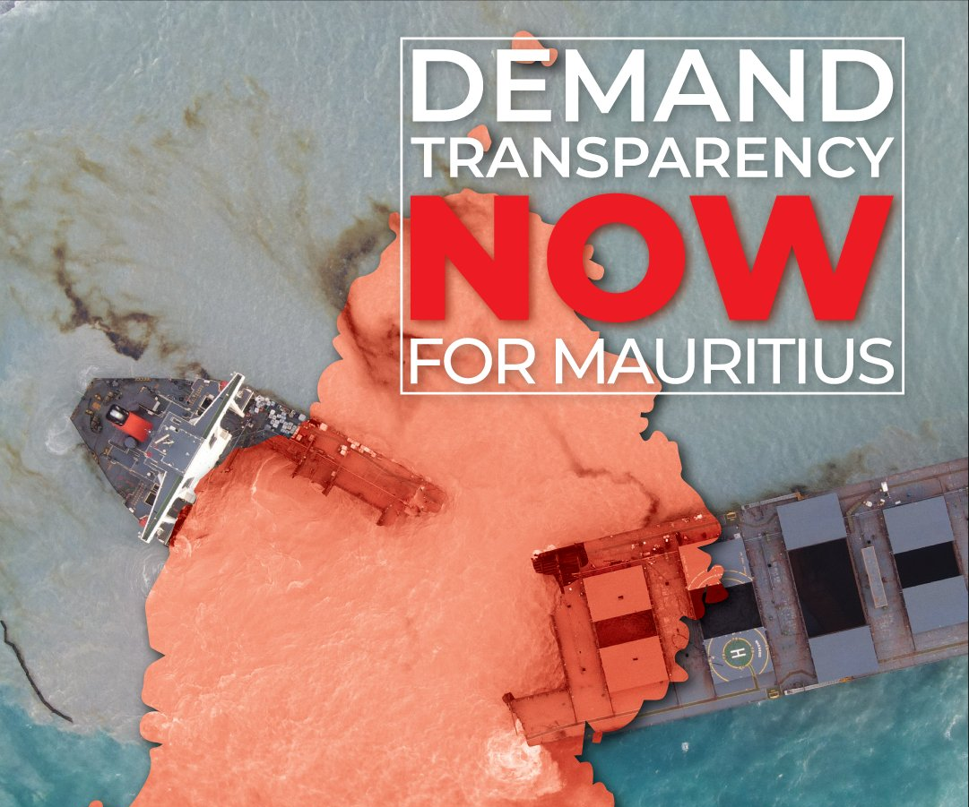
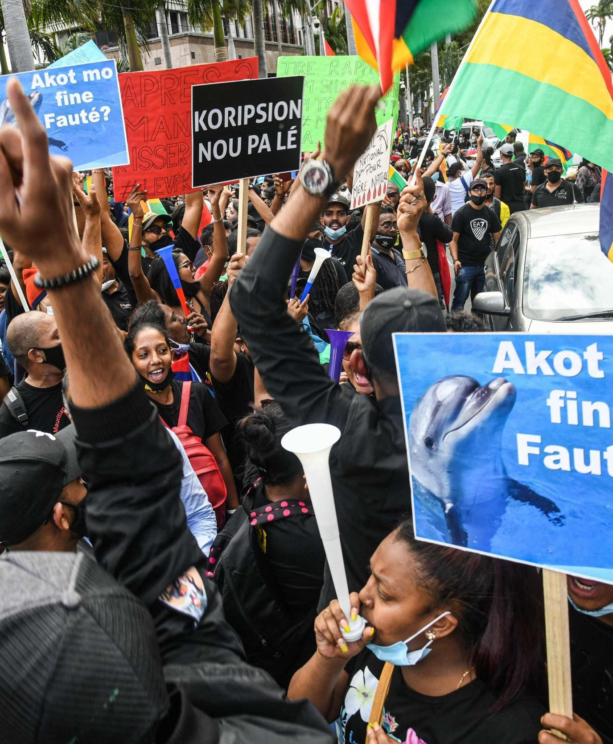
Social Impact
100,000 protesters in capital Port Louise 3 weeks after the spill
Criticism towards the government for the poor handling of the spill
No actions taken for 2 weeks (July 25 – Aug 6)
Called the Prime Minister to step down
Demonstrations also happened in London, Paris, Geneva, Canada
Jan 11: militarized police was deployed against protestors

Slide 7
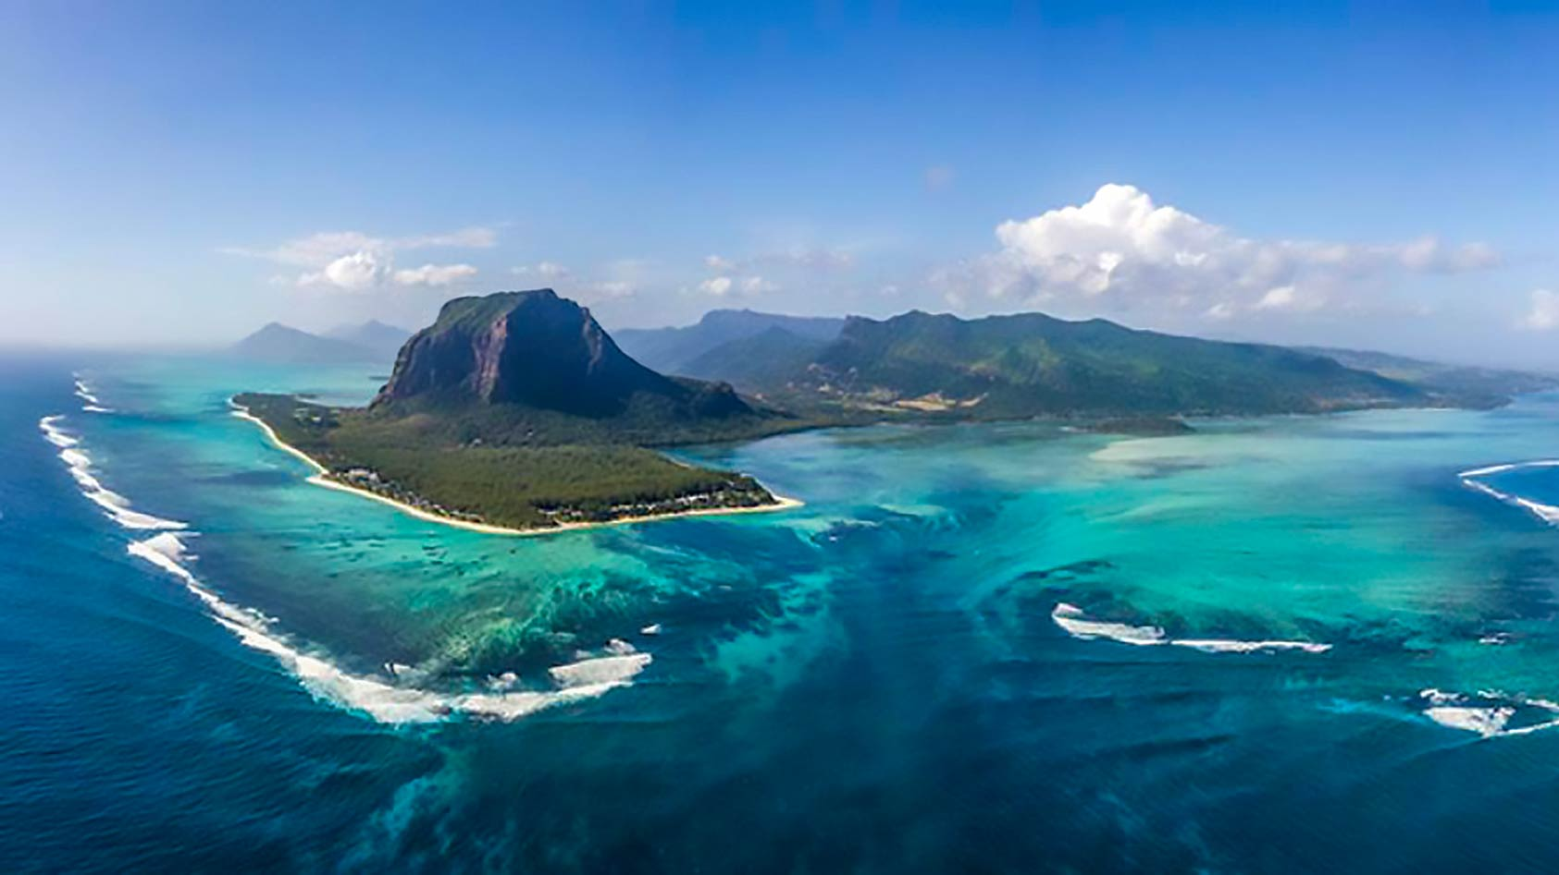
Thank you!

