Slide 1
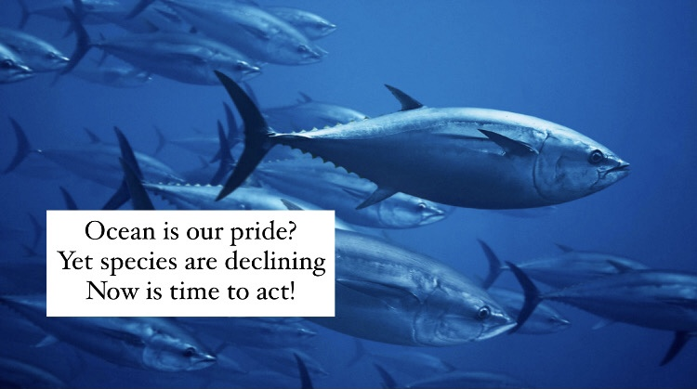
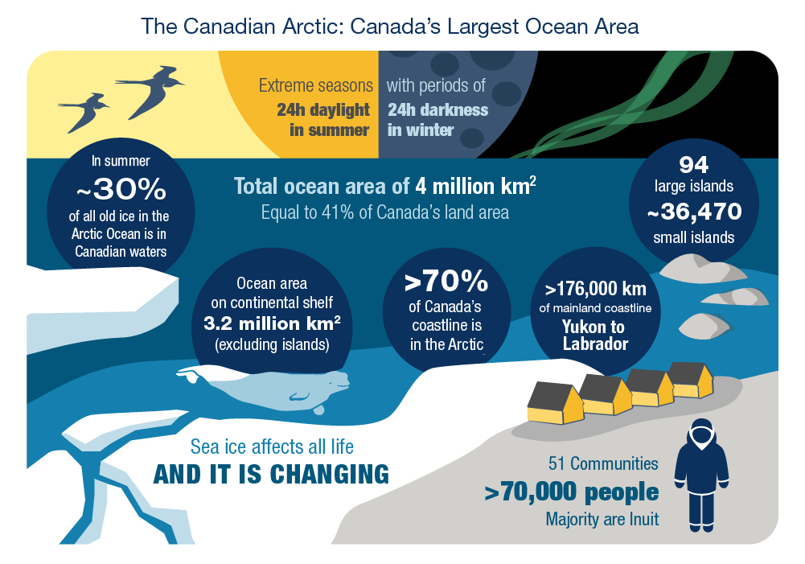
Twitter Handle: @MaiAdalynn
There's 36% overall decline of ocean species from 1970-2012. There are currently 140 species found in Canadian waters listed under Species at Risk Act. In Aug 2019, Canada reached the goal to conserve 10% of coastal and marine areas. #OceanConsvnUBC https://www.dfo-mpo.gc.ca/oceans/conservation/plan/index-eng.html
Haiku on Status of Marine Species

